Slide 1

FTDS-Aug 2022 Machine Learning Project Stock price Prediction
Anmol Thadani

Slide 2

Content
Aim of this project
Business Value
Data collection and pre-processing
Exploratory Data Analysis
Machine Learning Algorithm
Hyperparameter Tuning
Sentiment Analysis
Challenges
Conclusion

Slide 3


Aim of this project
To help in discovering the future value of a company’s stock and other financial assets traded on an exchange
End goal in prediction is to gain profits

Slide 4
Business Value
When a price steadily increase, it is an indicator that a company is steering its operations towards profitability
This attracts potential investors since a higher share price increases customer’s interest as they would naturally expect a higher return
This will allow companies to attract high quality employees with stock prices going up.

Slide 5
Data COLLECTION AND PREPROCESSING
Extracted from yahoo finance
Steps in processing our data
Understand the data
Import Relevant libraries
Create our own variables per data frame
Convert date column using a DateTime object
Conduct EDA
Check if any null values
Repeat the process with time series and classification analysis

Slide 6
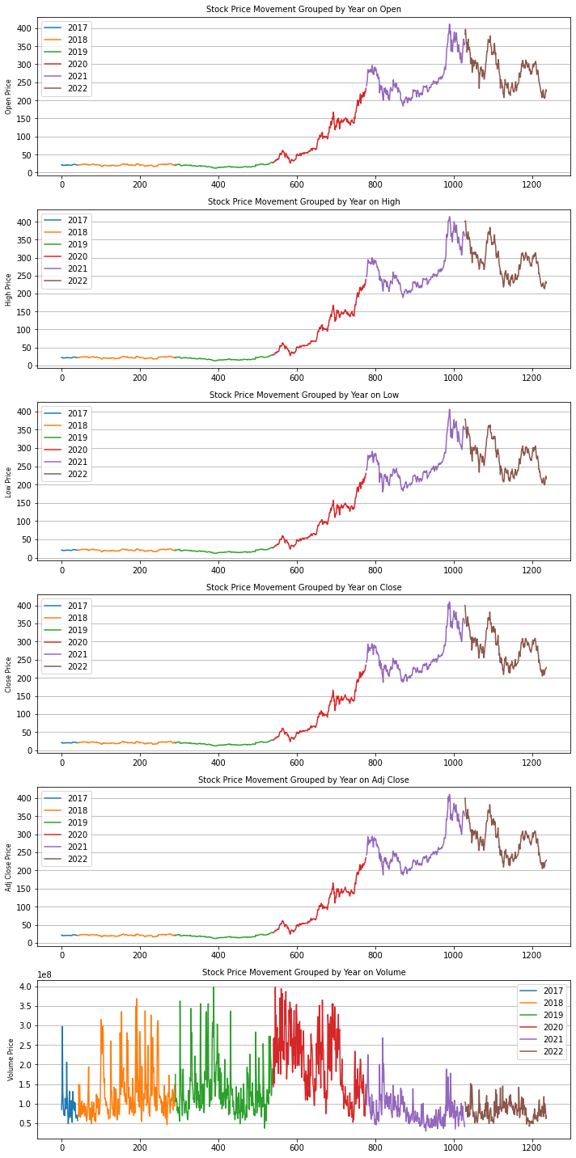
EXPLORATORY DATA ANALYSIS FOR TESLA

Slide 7
MACHINE LEARNING MODELS
Facebook Prophet
ARIMA
Classification Models
Logistic Regression
SVC
XGB Classifier

Slide 8
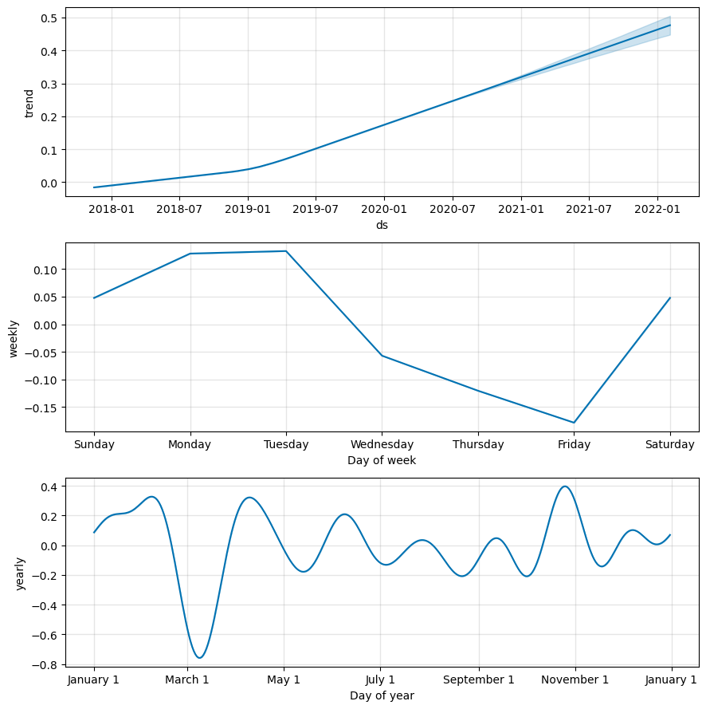
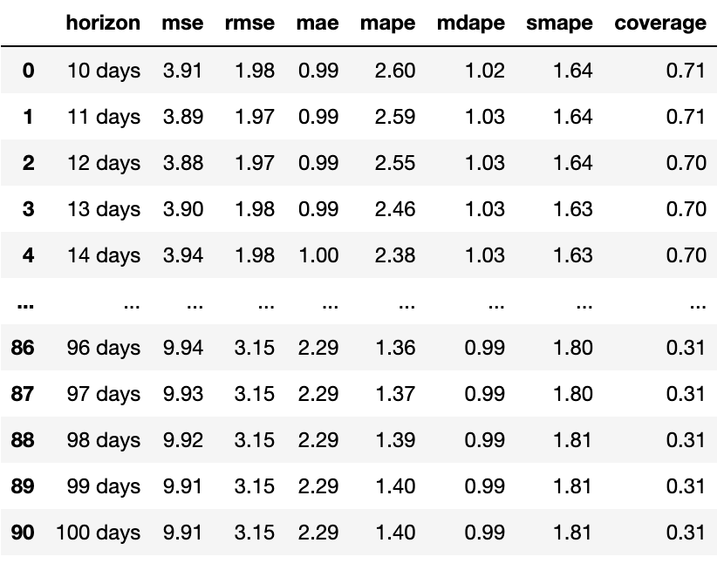
Facebook prophet (Tesla)
MSE = 7.345577441078143
RMSE = 2.683795045666881

Slide 9
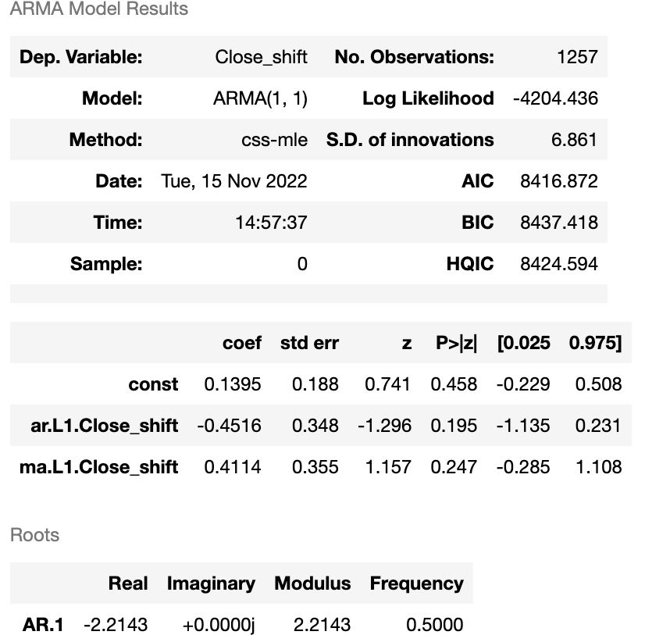
ARIMA (TESLA)

Slide 10
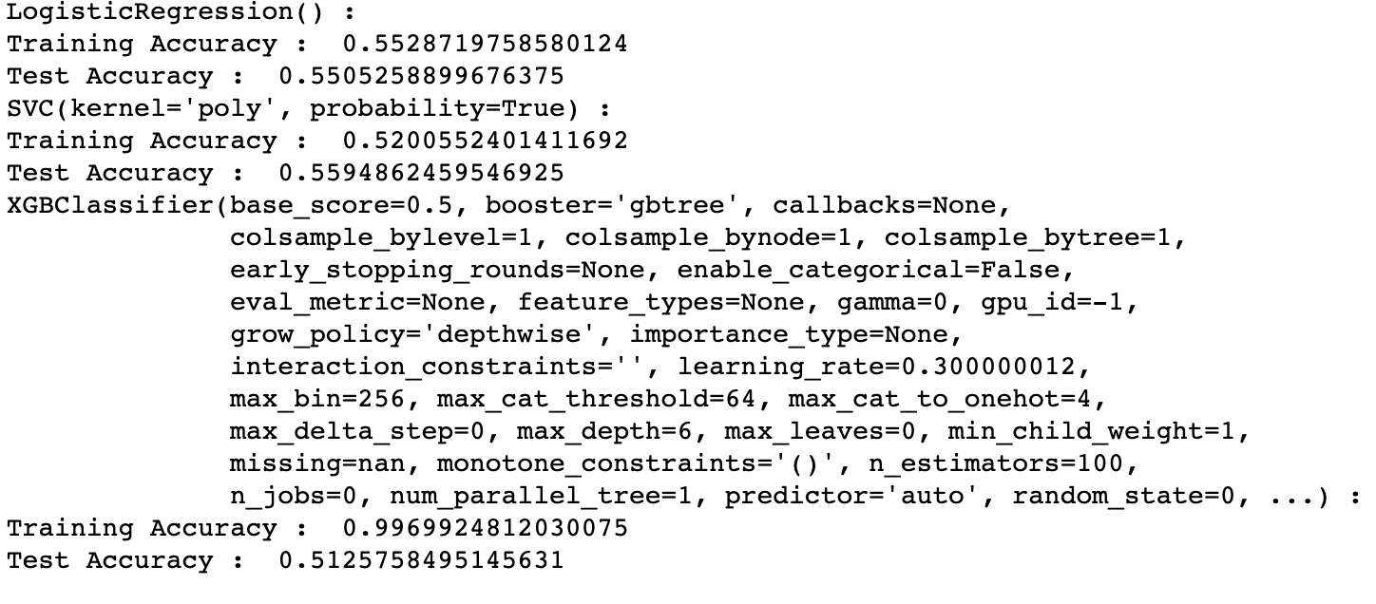
CLASSIFICATION (TESLA)
With comparison to the three classification, we can see that XGBClassifier is performing extraordinary. Hence we will assume that it is the best performer in terms of classification .

Slide 11
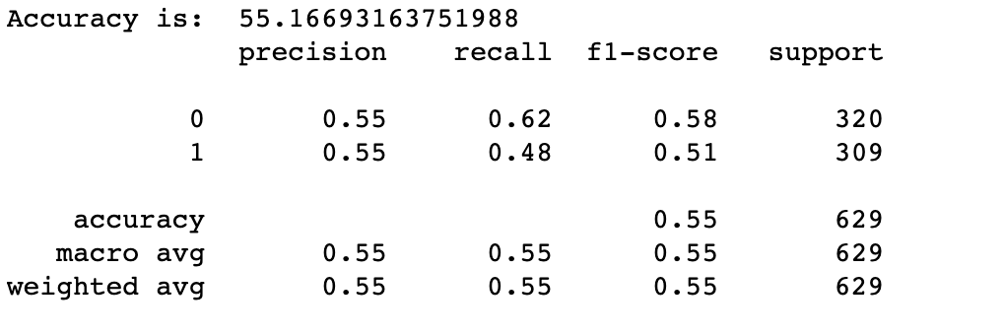
HYPERPARAMETER TUNING (TESLA)

Slide 12
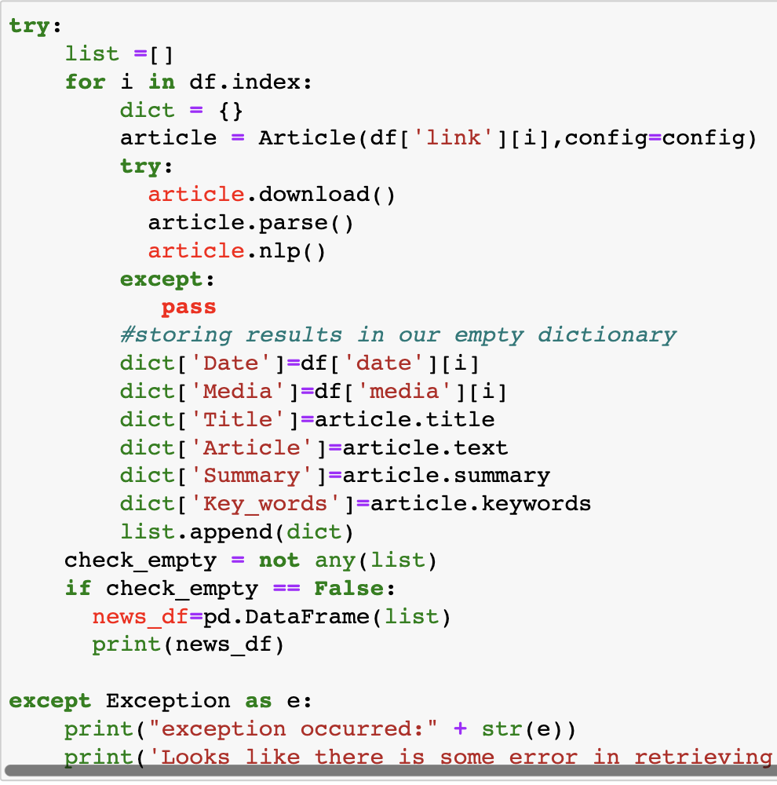
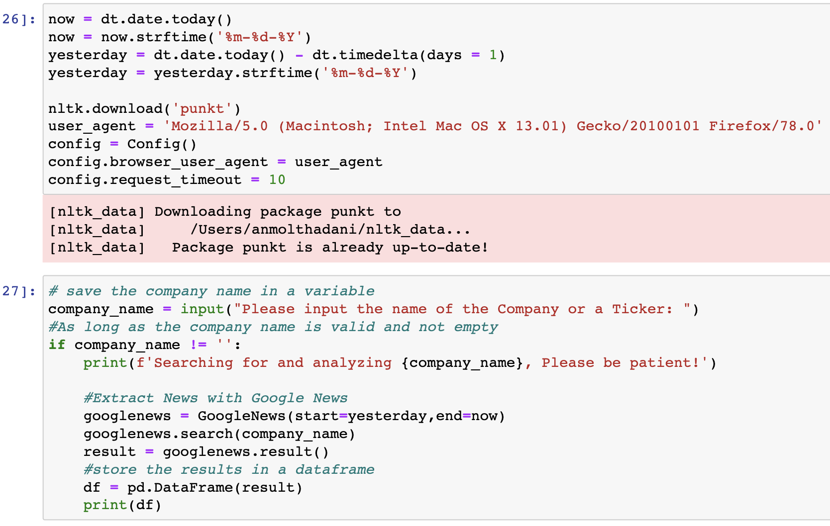
Sentiment ANalysis

Slide 13
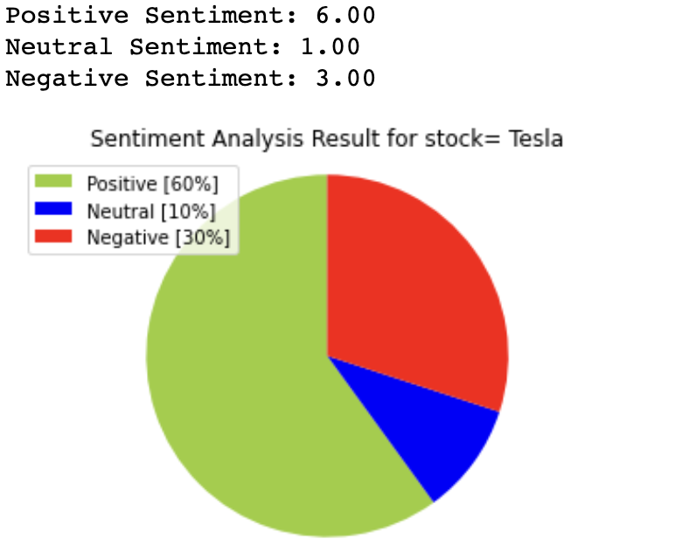
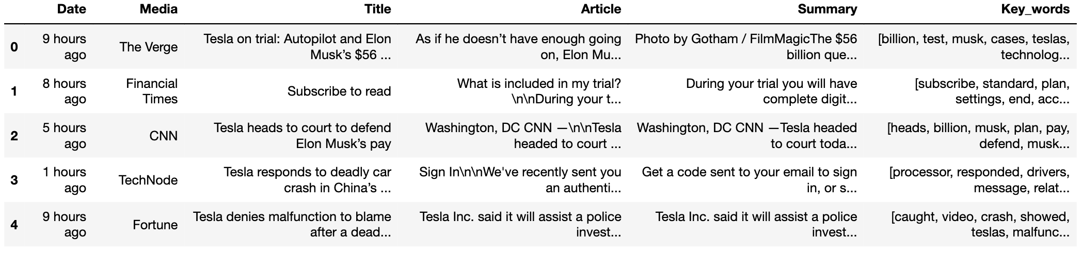

Slide 15
challenges
As the accuracy score in PCA is relatively low, this was due to the case of underfitting in which a particular classification model fails to fit any trend to the data

Slide 16

THE END

